Slide 1
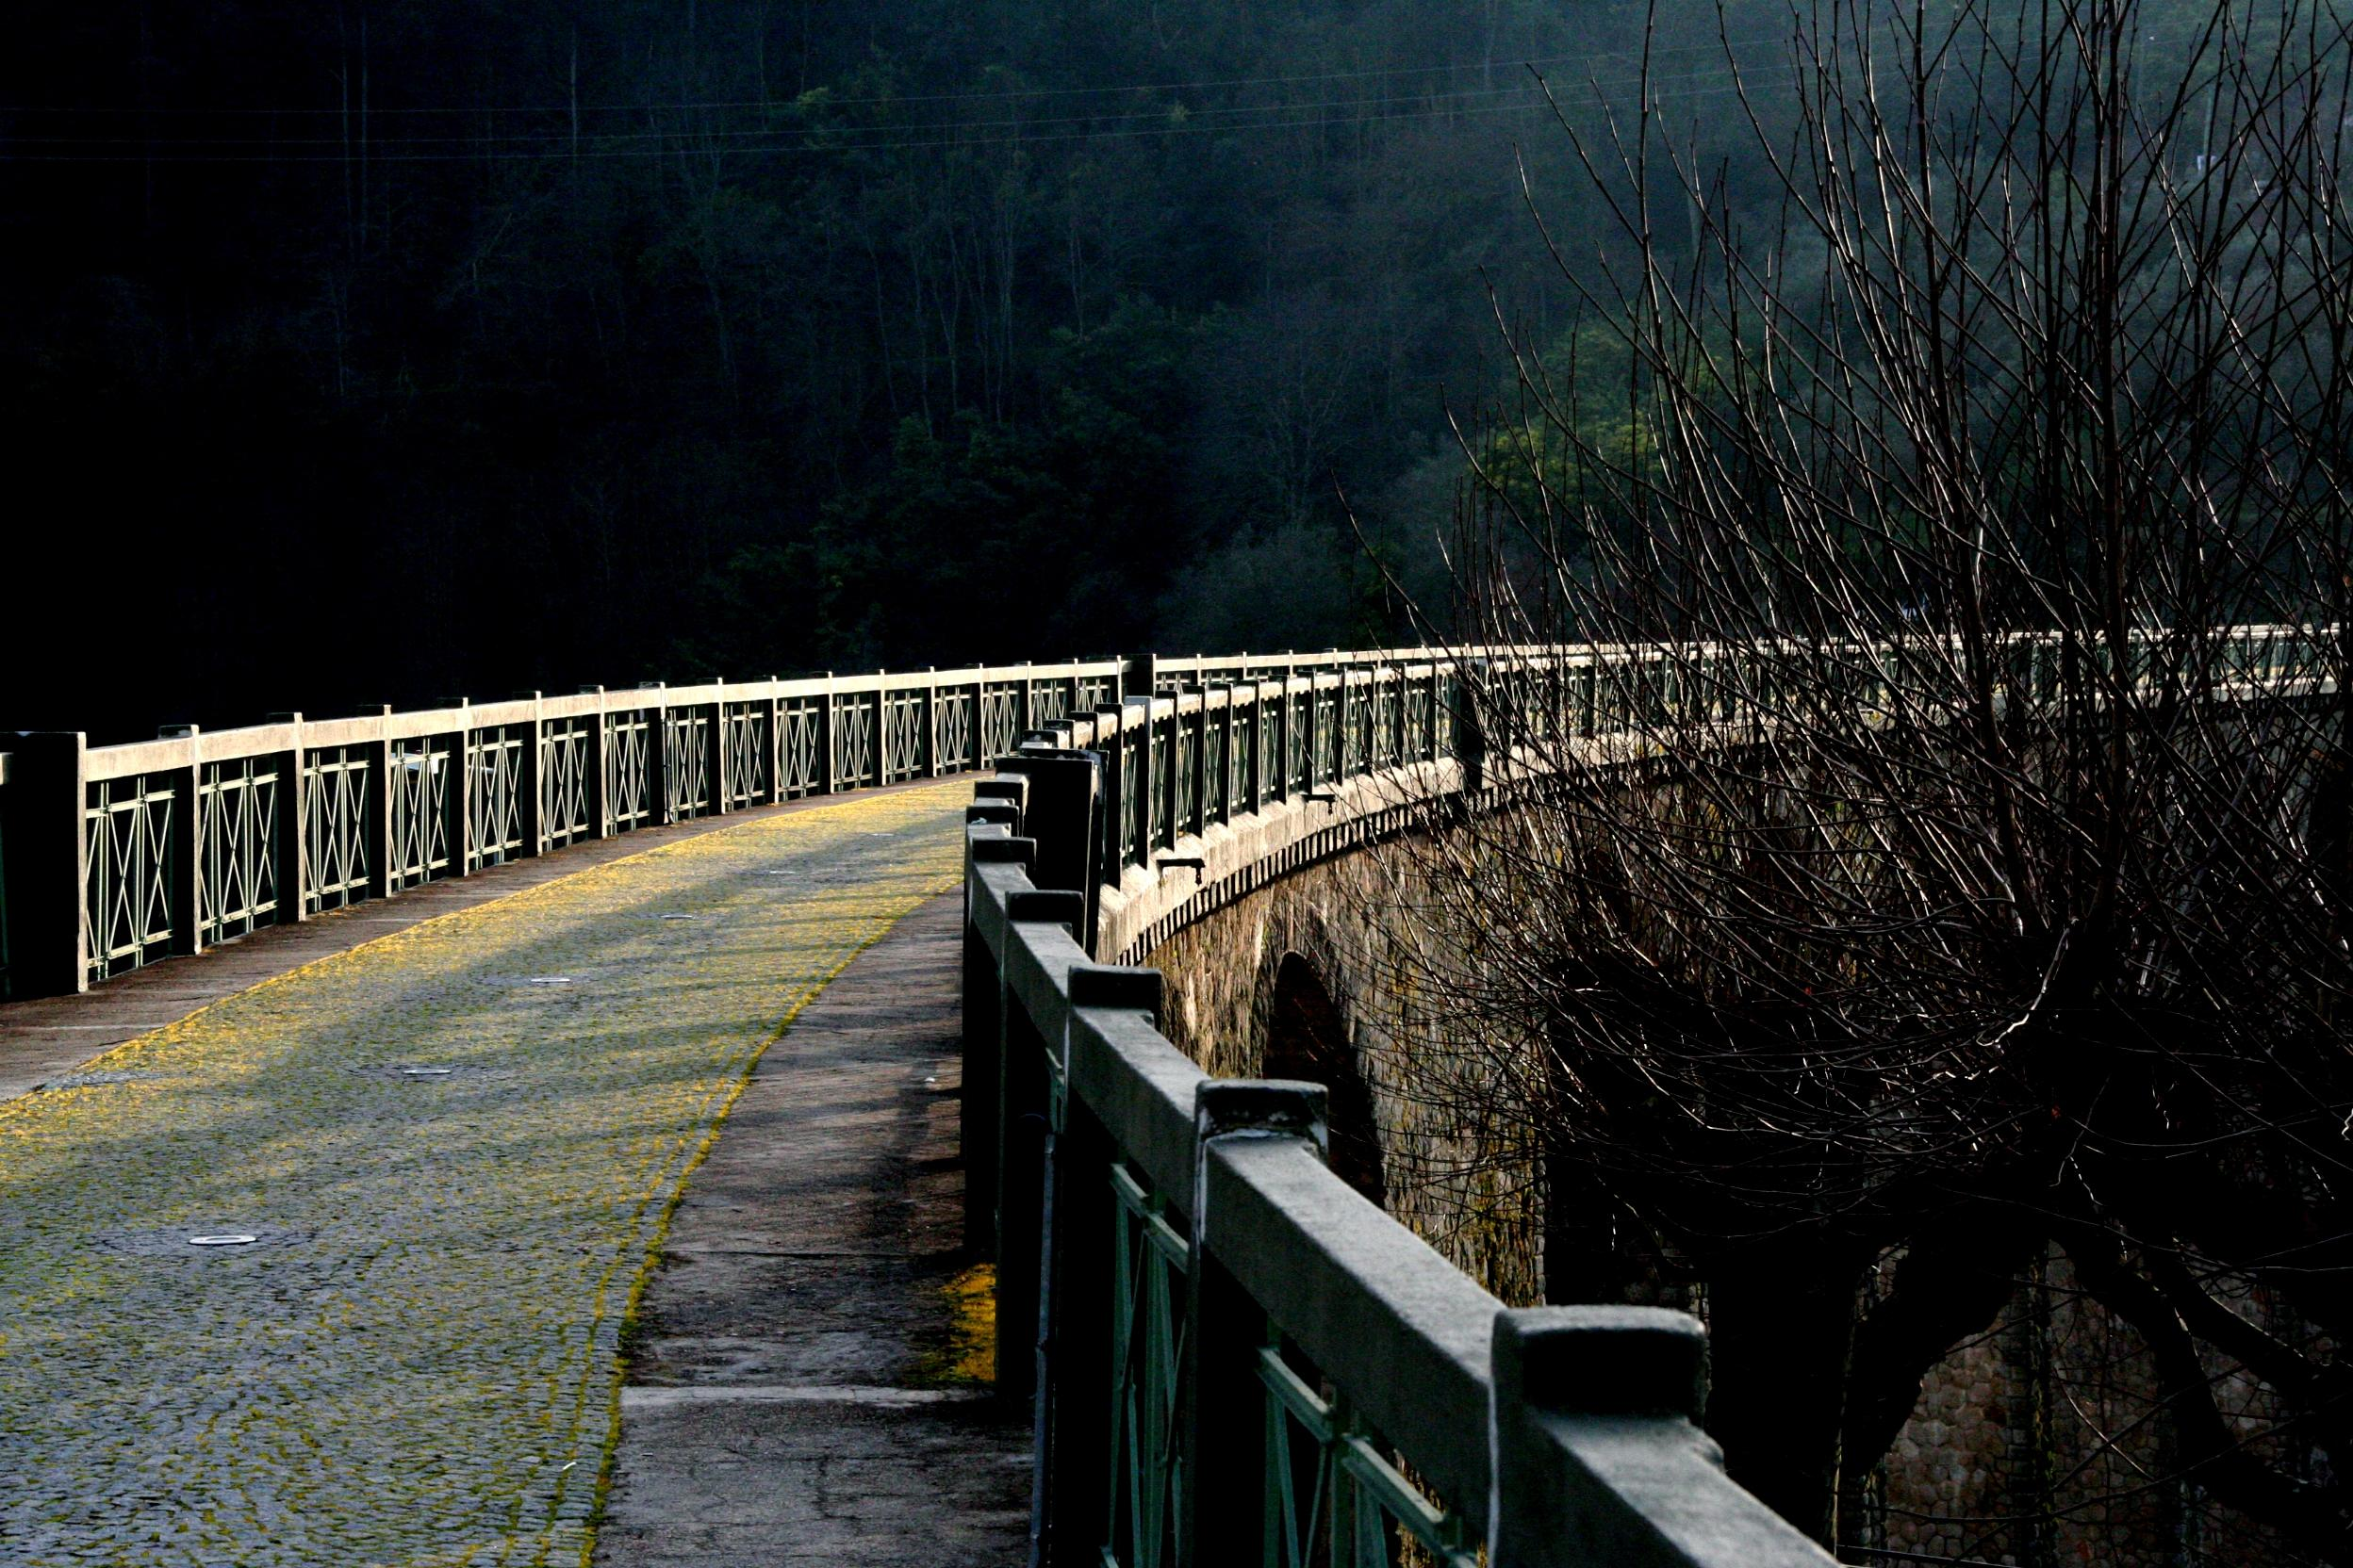
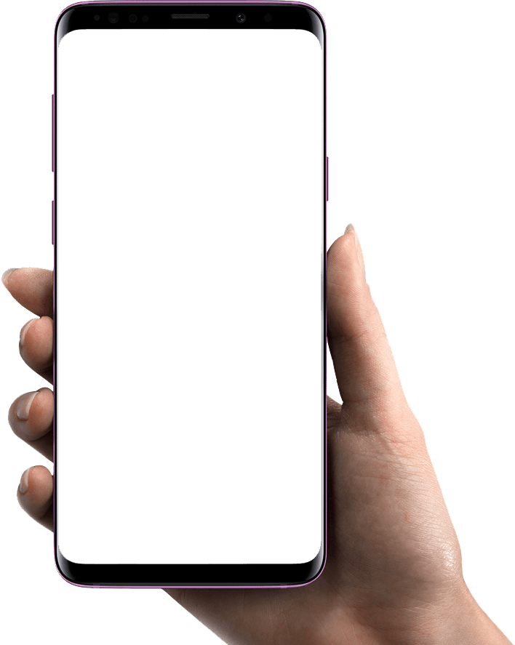

Vouzela
Aplicação Vouzela
Human-Computer Interaction
12th march 2020
P6
Hugo Paiva de Almeida 93195 LEI
Rui Fernandes 92952 LEI
Carlos Michell Sena 81377 LEI

Slide 2




Why this product?
Basic UI
Unique application
Help the
developer

Slide 3
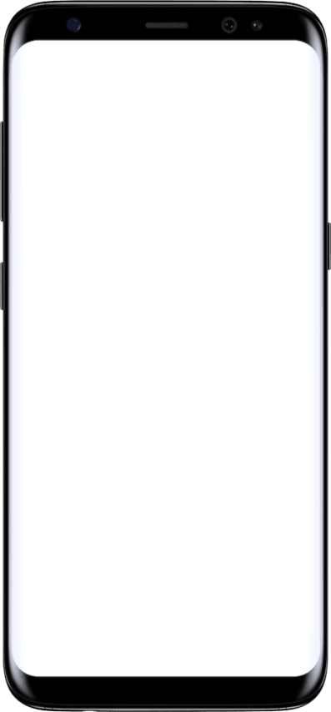

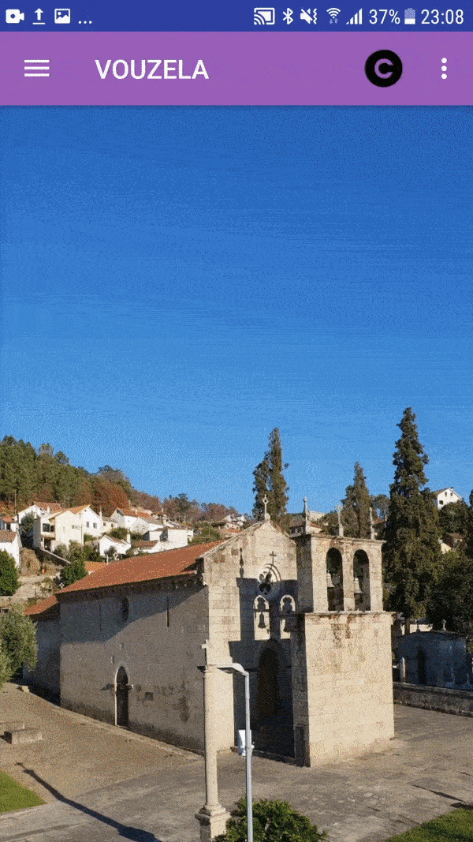



Product Description
Product
Vouzela app for Android is an application developed by a vouzelense with the purpose of promoting Vouzela
Objectives
Promote the county with the history, places to eat, to stay and main points of interest
Target Users
Tourists and people that want to visit and know Vouzela
UI Aspects
Application based on a sidebar menu with access to various aspects of Vouzela such as history, restaurants, bars, etc.

Slide 4


Evaluation Methods
Heuristic Evaluation
Cognitive Walkthrough
Based on Nielsen’s 10 general usability heuristics
The severity of usability problems was rated on 0 to 4 scale
Based on Spencer’s Streamlined Cognitive Walkthrough
Tasks analysis and report of potential issues

Slide 5

HE Table
 | Hugo |  | Rui |  | Carlos
 | Found By | Severity | Found By | Severity | Found By | Severity
Unimportant “About Us” button |  | 1 |  | 1 |  | 1
Low resolution icons |  | 1 |  | 1 |  | 1
No rotation |  | 2 |  | 2 |  | 2
Basic Android interface |  | 1 |  | 1 |  | 1
Limited/outdated information displayed |  | 2 |  | 3 |  | 3
Viewing events only online |  | 3 |  |  |  | 2
Route viewing not intuitive |  |  |  | 1 |  | 1
Hidden search button |  | 3 |  | 2 |  | 3
Confusing calendar function |  | 3 |  | 2
Empty homepage |  | 4 |  | 2 |  | 3
Only 1 language |  | 4 |  | 3 |  | 3
Lackluster Interactive map |  | 2 |  | 2 |  | 2

Slide 6
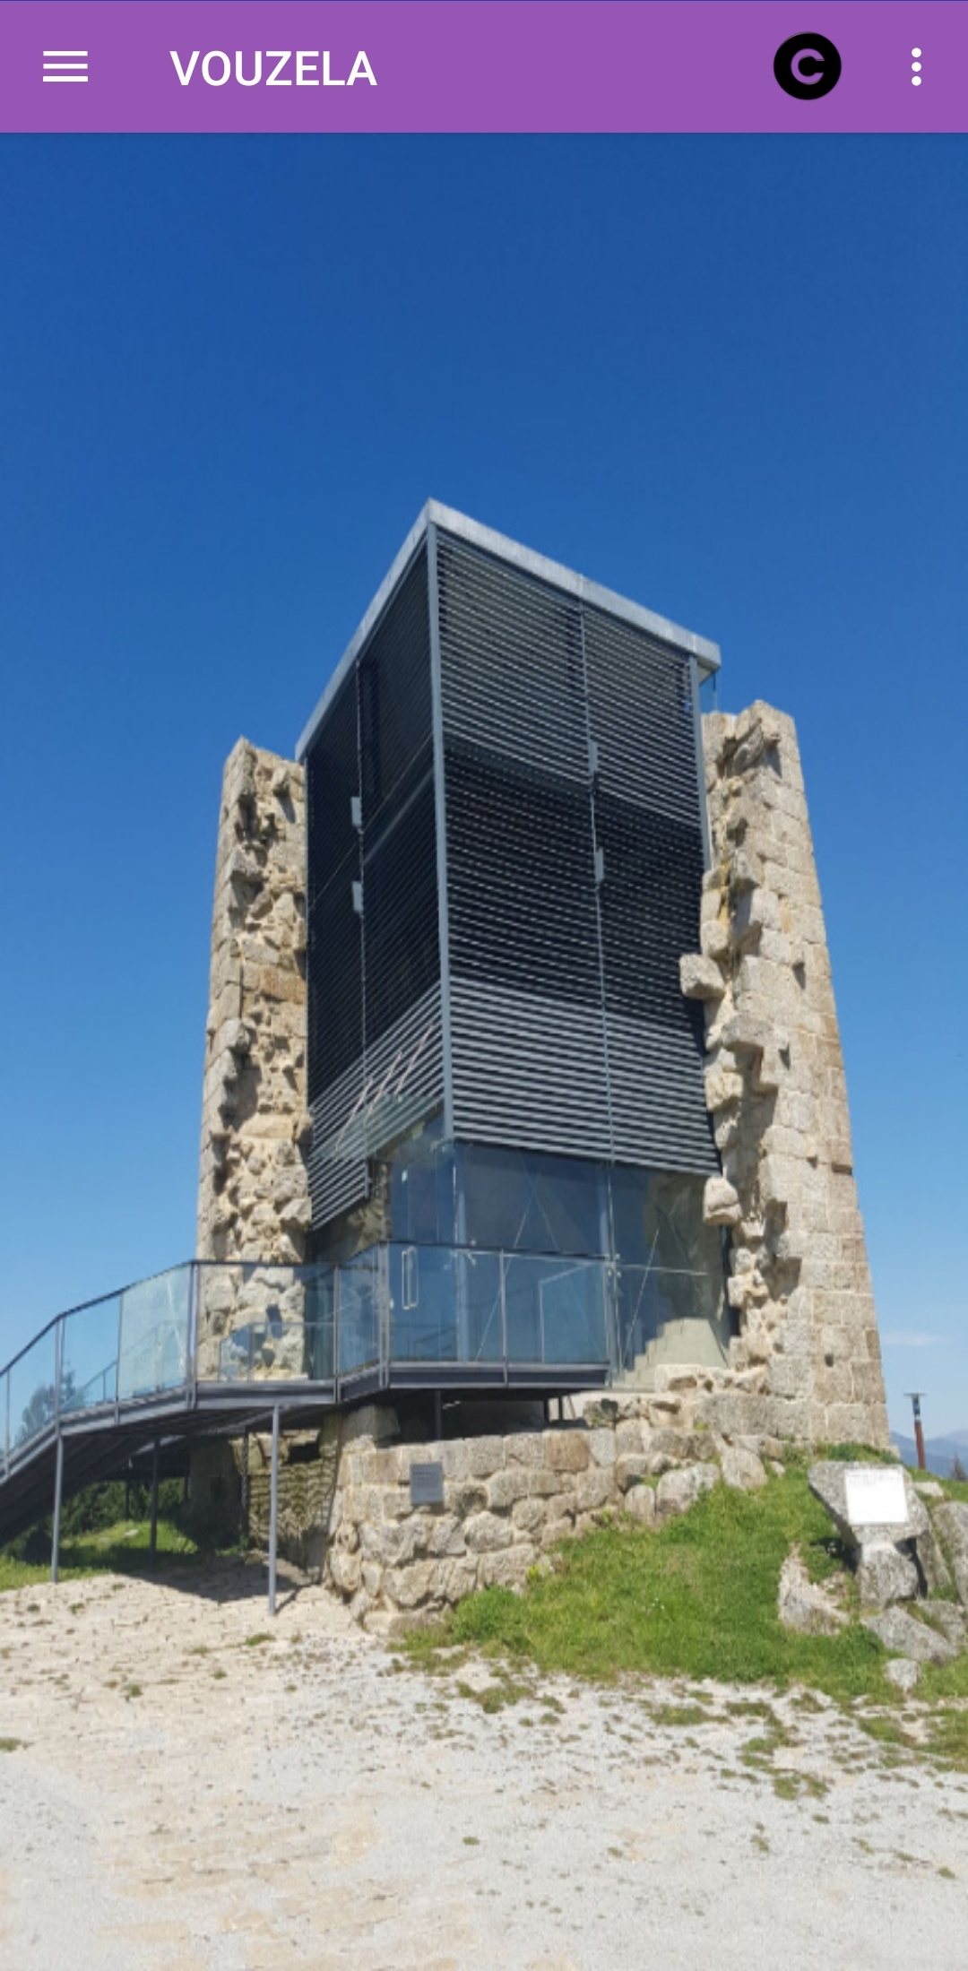




Heuristic Evaluation
Issue: Empty homepage
Heuristic: Flexibility and efficiency of use
Severity: 3
Issue: Low resolution icons
Heuristic: Aesthetic and minimalist design
Severity: 1

Slide 7
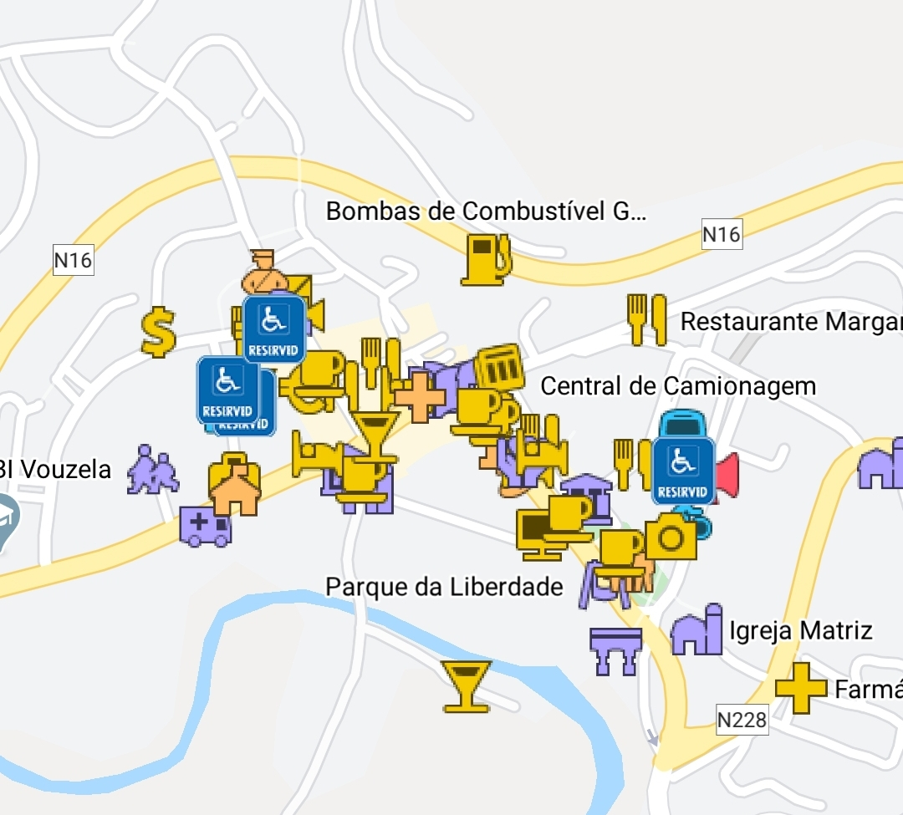
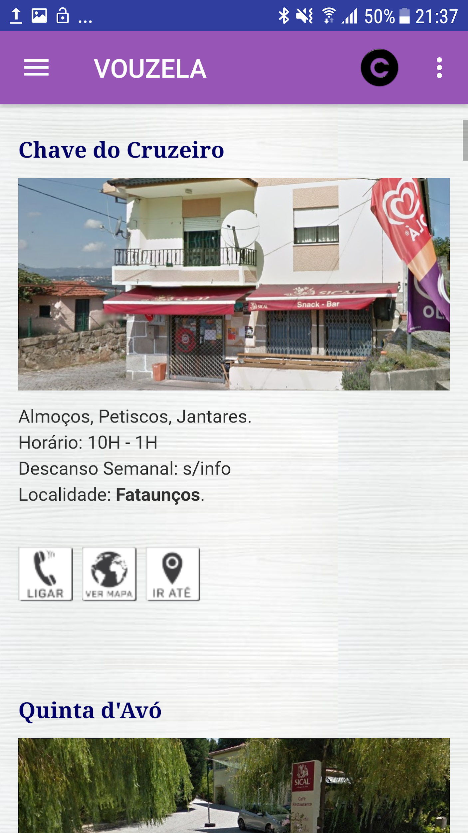
Heuristic Evaluation
Issue: Lackluster interactive map
Heuristic: Aesthetic and minimalist design
Severity: 2
Issue: Limited/outdated information displayed
Heuristic: Match between system and the real world
Severity: 3

Slide 8
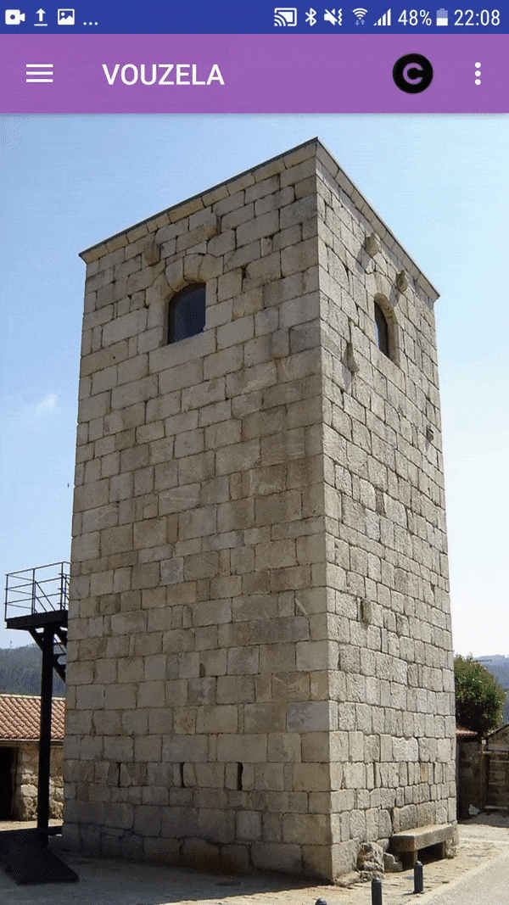
Heuristic Evaluation
Issue: Unimportant “About Us” button
Heuristic: Aesthetic and minimalist design
Severity: 1
Issue: Hidden search button
Heuristic: Flexibility and efficiency of use
Severity: 2

Slide 9
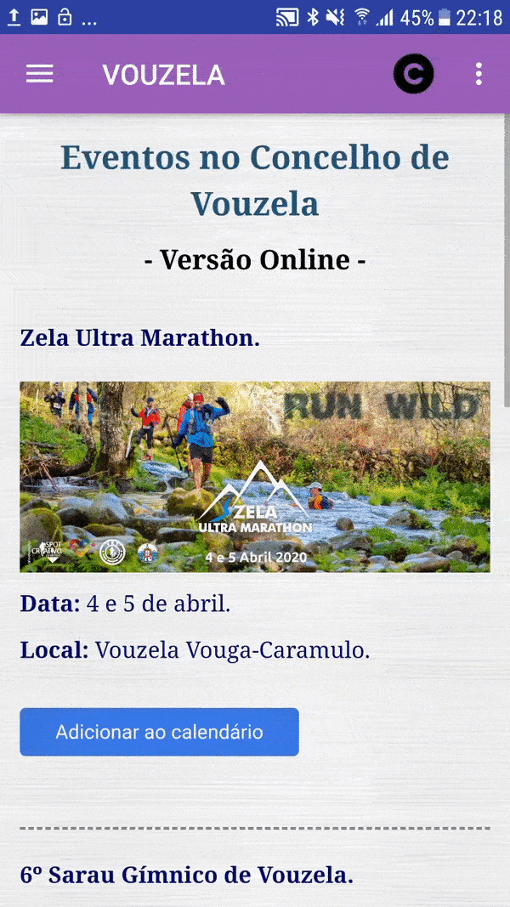
Heuristic Evaluation
Issue: Confusing calendar function
Heuristic: Flexibility and efficiency of use
Severity: 3
Issue: Only 1 language
Heuristic: Match between system and the real world
Severity: 3
Issue: No rotation
Heuristic: Flexibility and efficiency of use
Severity: 2

Slide 10
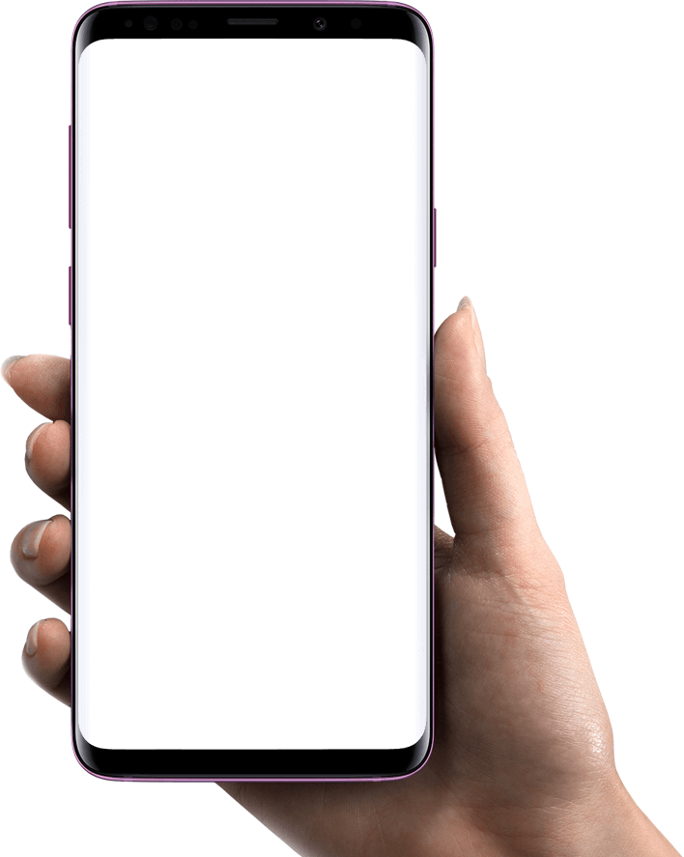
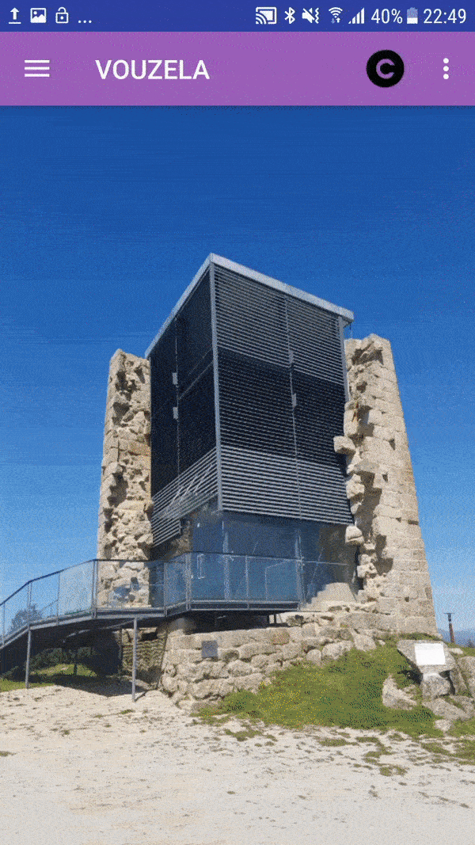


Cognitive Walkthrough
Task: Find how to get to Vouzela
Target User
Tourist
Steps
Go to the sidebar menu
Click on the more information button
Get the route

Slide 11
Cognitive Walkthrough
Task: Find how to get to Vouzela
Go to the sidebar menu
Will the user know what to do at this step?
Yes, the sidebar toggle is visible.
If the user does the right thing, will they know that they did the right thing, and are making progress towards their goal?
Yes, just after the user click on the toggle, the sidebar with all the options is visible.
1
Click on the more informations button
Will the user know what to do at this step?
No, a normal user doesn’t know that he can get this information on this tab.
If the user does the right thing, will they know that they did the right thing, and are making progress towards their goal?
Yes, the application shows the intended information.
2
Get the route
3
Will the user know what to do at this step?
No. Other than reading the text, the user doesn’t know what to do.
If the user does the right thing, will they know that they did the right thing, and are making progress towards their goal?
No, the user can’t get the route, for example, in Google Maps.

Slide 12

Cognitive Walkthrough
Task: Find the restaurant’s “Quinta Da Cavada” location
Target User
Tourist
Steps
Click on the three dots on the top right corner
Click on “Pesquisar”
Write on the search bar the restaurant name
Click on the result

Slide 13
Cognitive Walkthrough
Task: Find the restaurant’s “Quinta Da Cavada” location
Click on the three dots on the top right corner
Will the user know what to do at this step?
No, the user will never know beforehand the search is there.
If the user does the right thing, will they know that they did the right thing, and are making progress towards their goal?
Yes, just after the user click on the threed dots, a button to search is visible.
1
Click on “pesquisar”
Will the user know what to do at this step?
Yes, the button is visible and clear.
If the user does the right thing, will they know that they did the right thing, and are making progress towards their goal?
Yes, the search bar is showed.
2
Write on the search bar the restaurant name
3
Click on the result
Will the user know what to do at this step?
Yes, it’s showed a search bar for restaurants and accommodation.
If the user does the right thing, will they know that they did the right thing, and are making progress towards their goal?
Yes, the application starts to show results as the user types.
4
Will the user know what to do at this step?
Yes, it’s said to click on the card.
If the user does the right thing, will they know that they did the right thing, and are making progress towards their goal?
Yes, the Google Maps application opens with the intended information.

Slide 14



Final Appreciation
Serves its purpose but it’s advised to fix the potential problems
Overall, an unappealing design
Has potential to be a great asset to the county of Vouzela

